Slide 1





























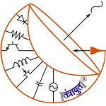






Slide 2


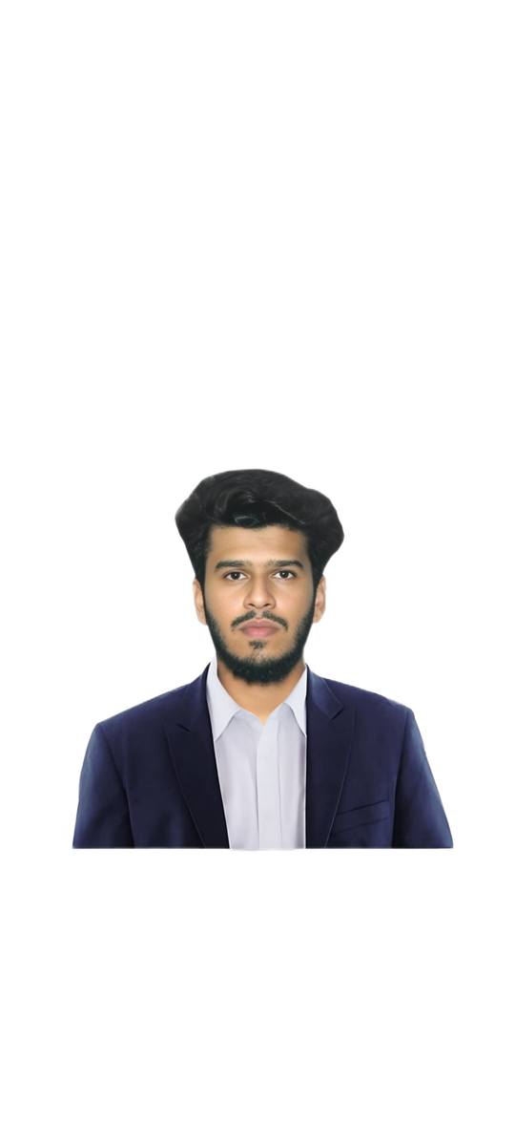





The Bombay Salesian Society’s DON BOSCO INSTITUTE OF TECHNOLOGY (An Autonomous Institute Affiliated to University of Mumbai)
Department of Mechanical Engineering
Batch(2024-25)
DTE : EN 3208
Congratulations
Placed In
Nishant
Suryavanshi
9.5 LPA
Saeem Kable
9.5 LPA
Help Each Other - Don Bosco
placementcell_dbit
www.dbit.in
Don Bosco Institute of Technology (D.B.I.T )

Slide 3
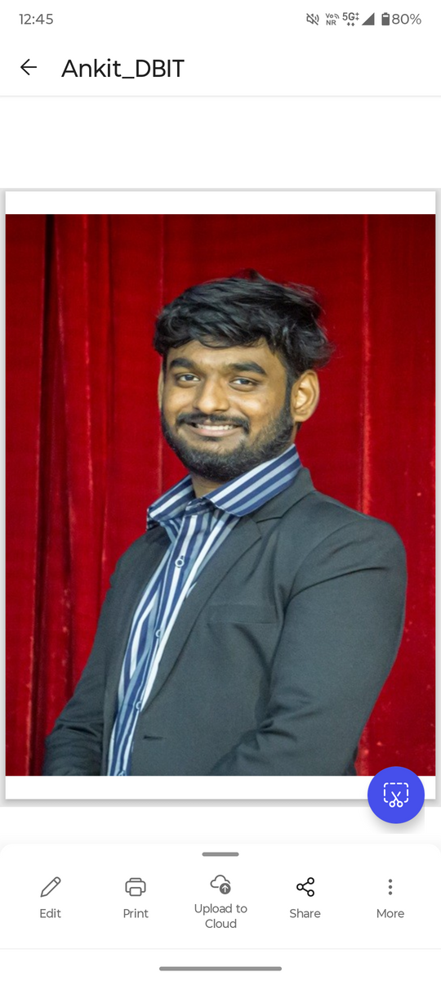
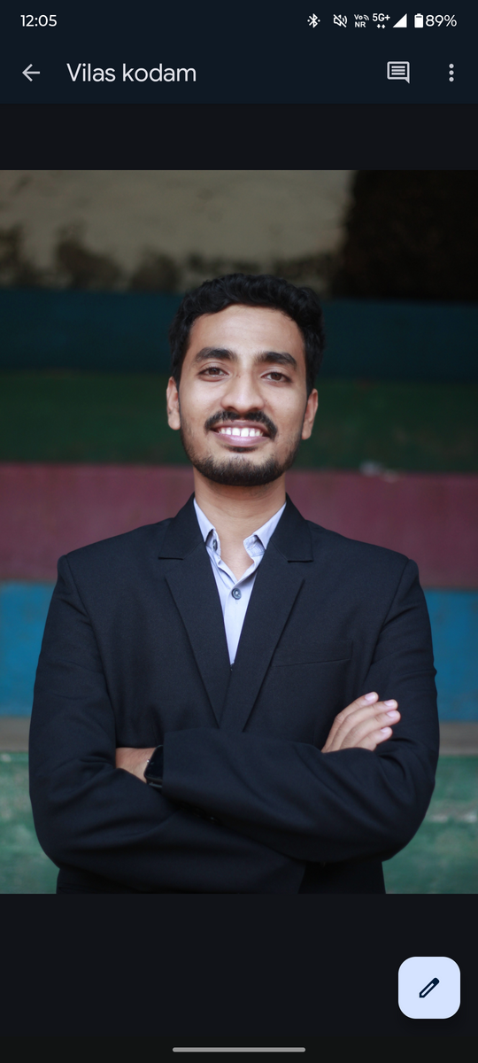

The Bombay Salesian Society’s DON BOSCO INSTITUTE OF TECHNOLOGY (An Autonomous Institute Affiliated to University of Mumbai)
Department of Mechanical Engineering
Batch(2024-25)
DTE : EN 3208
Congratulations
Placed In
Vilas kodam
9 LPA
Ankit
Kshirsagar
9 LPA
Help Each Other - Don Bosco
placementcell_dbit
www.dbit.in
Don Bosco Institute of Technology (D.B.I.T )

Slide 4

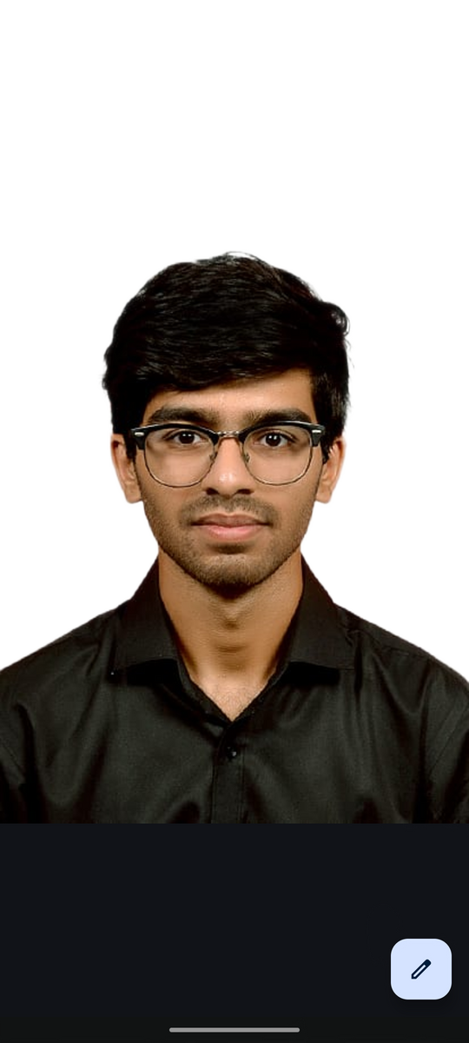

The Bombay Salesian Society’s DON BOSCO INSTITUTE OF TECHNOLOGY (An Autonomous Institute Affiliated to University of Mumbai)
Department of Mechanical Engineering
Batch(2024-25)
DTE : EN 3208
Congratulations
Placed In
Ved Yemitkar
7.75 LPA
Bhavik Patil
7.75 LPA
Help Each Other - Don Bosco
placementcell_dbit
www.dbit.in
Don Bosco Institute of Technology (D.B.I.T )

Slide 5
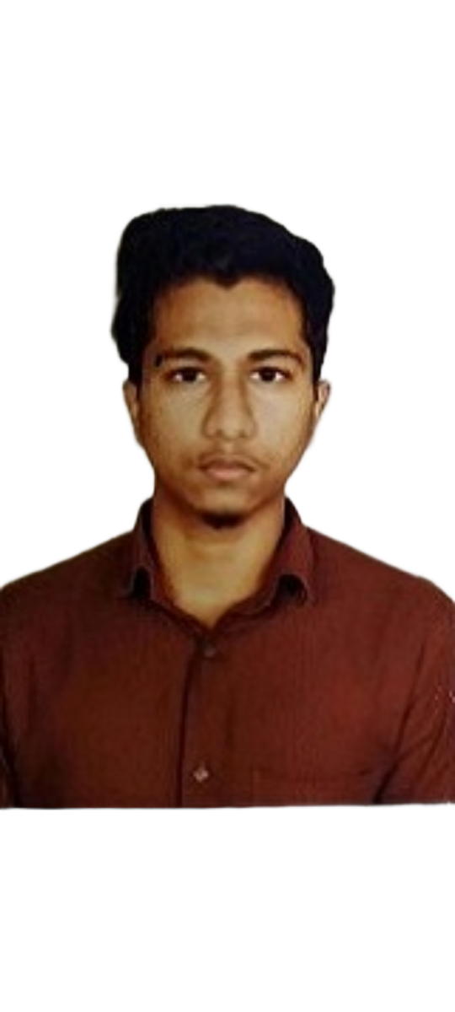
The Bombay Salesian Society’s DON BOSCO INSTITUTE OF TECHNOLOGY (An Autonomous Institute Affiliated to University of Mumbai)
Department of Mechanical Engineering
Batch(2024-25)
DTE : EN 3208
Congratulations
Placed In
Hamdaan Ansari
7.75 LPA
Help Each Other - Don Bosco
placementcell_dbit
www.dbit.in
Don Bosco Institute of Technology (D.B.I.T )

Slide 6
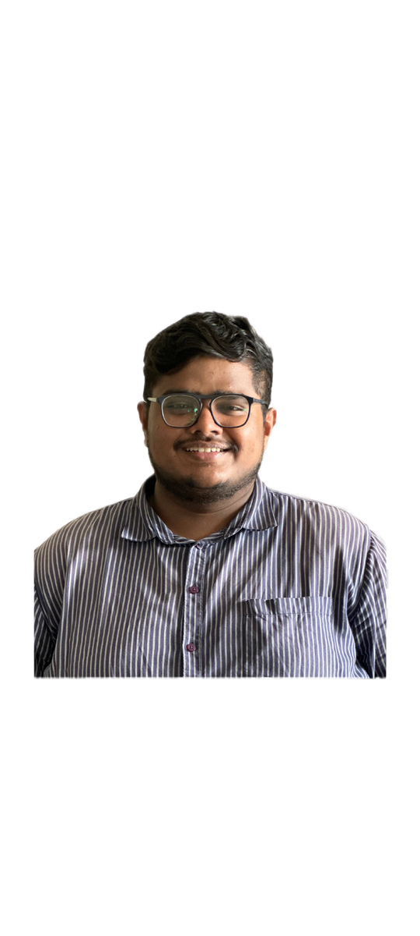
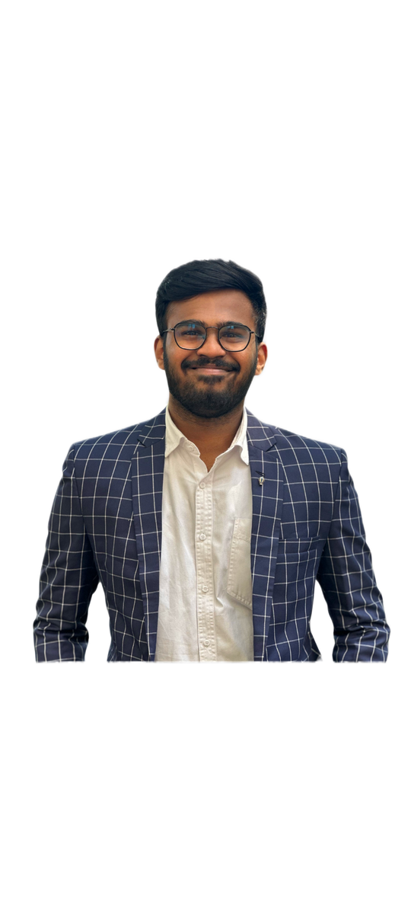

The Bombay Salesian Society’s DON BOSCO INSTITUTE OF TECHNOLOGY (An Autonomous Institute Affiliated to University of Mumbai)
Department of Mechanical Engineering
Batch(2024-25)
DTE : EN 3208
Congratulations
Placed In
Nirav Prabhu
7.2 LPA
Atharva Prabhu
7.2 LPA
Help Each Other - Don Bosco
placementcell_dbit
www.dbit.in
Don Bosco Institute of Technology (D.B.I.T )

Slide 7

The Bombay Salesian Society’s DON BOSCO INSTITUTE OF TECHNOLOGY (An Autonomous Institute Affiliated to University of Mumbai)
Department of Mechanical Engineering
Batch(2024-25)
DTE : EN 3208
Congratulations
Placed In
Ashish Desai
6.91 LPA
Help Each Other - Don Bosco
placementcell_dbit
www.dbit.in
Don Bosco Institute of Technology (D.B.I.T )

Slide 8
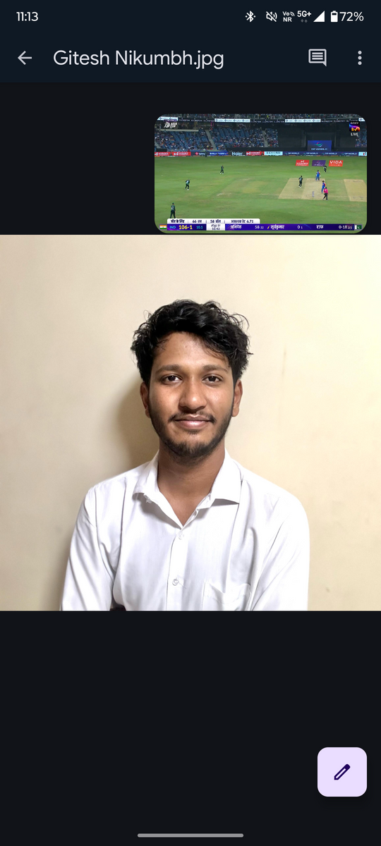

The Bombay Salesian Society’s DON BOSCO INSTITUTE OF TECHNOLOGY (An Autonomous Institute Affiliated to University of Mumbai)
Department of Mechanical Engineering
Batch(2024-25)
DTE : EN 3208
Congratulations
Placed In
Gitesh Nikumb
6 LPA
Help Each Other - Don Bosco
placementcell_dbit
www.dbit.in
Don Bosco Institute of Technology (D.B.I.T )

Slide 9
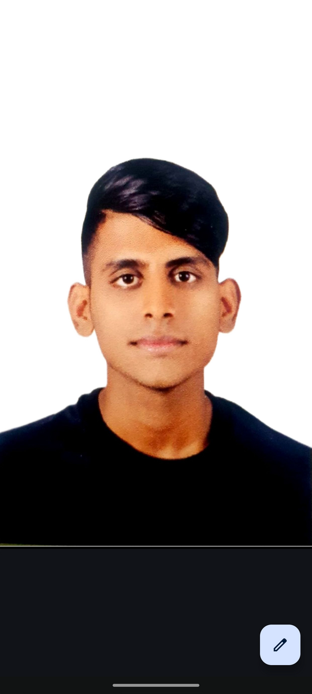


The Bombay Salesian Society’s DON BOSCO INSTITUTE OF TECHNOLOGY (An Autonomous Institute Affiliated to University of Mumbai)
Department of Mechanical Engineering
Batch(2024-25)
DTE : EN 3208
Congratulations
Placed In
Zafir Siddique
6 LPA
Ikram Khan
6 LPA
Help Each Other - Don Bosco
placementcell_dbit
www.dbit.in
Don Bosco Institute of Technology (D.B.I.T )

Slide 10

The Bombay Salesian Society’s DON BOSCO INSTITUTE OF TECHNOLOGY (An Autonomous Institute Affiliated to University of Mumbai)
Department of Mechanical Engineering
Batch(2024-25)
DTE : EN 3208
Congratulations
Placed In
Atharva Bomble
6 LPA
Help Each Other - Don Bosco
placementcell_dbit
www.dbit.in
Don Bosco Institute of Technology (D.B.I.T )

Slide 11

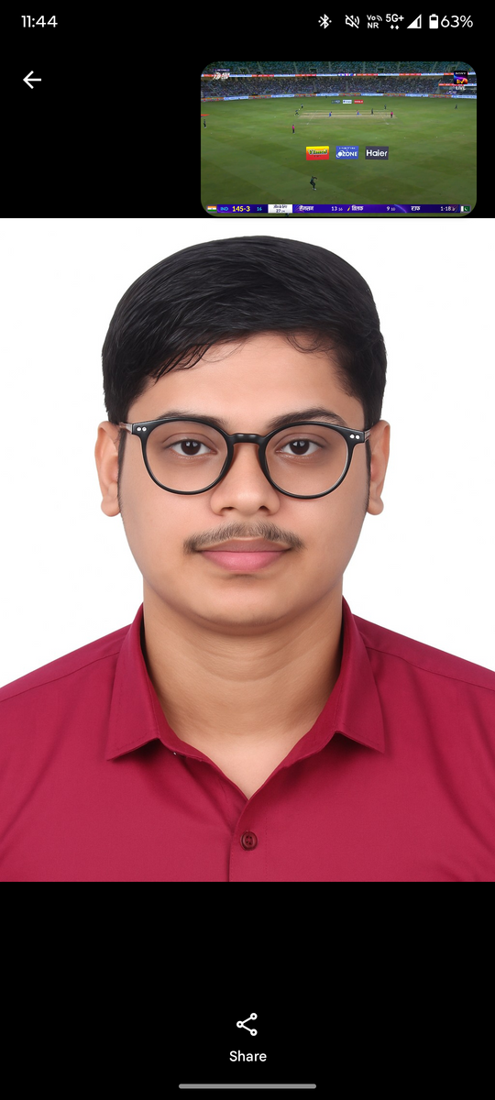

The Bombay Salesian Society’s DON BOSCO INSTITUTE OF TECHNOLOGY (An Autonomous Institute Affiliated to University of Mumbai)
Department of Mechanical Engineering
Batch(2024-25)
DTE : EN 3208
Congratulations
Placed In
Sujit Sahu
5.5 LPA
Rehan muqri
5.5 LPA
Help Each Other - Don Bosco
placementcell_dbit
www.dbit.in
Don Bosco Institute of Technology (D.B.I.T )

Slide 12
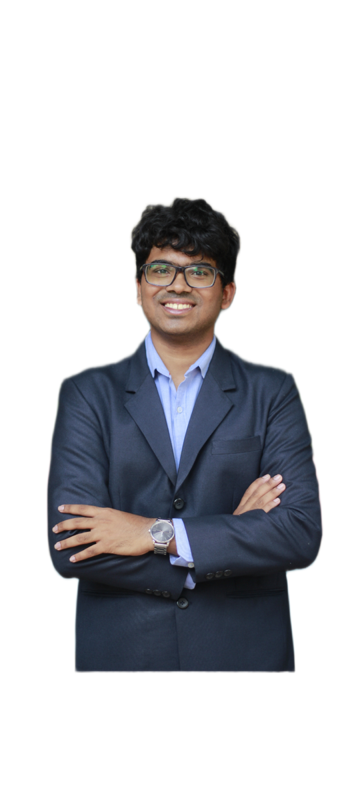

The Bombay Salesian Society’s DON BOSCO INSTITUTE OF TECHNOLOGY (An Autonomous Institute Affiliated to University of Mumbai)
Department of Mechanical Engineering
Batch(2024-25)
DTE : EN 3208
Congratulations
Placed In
Alden Fernandes
5.5
Help Each Other - Don Bosco
placementcell_dbit
www.dbit.in
Don Bosco Institute of Technology (D.B.I.T )

Slide 13


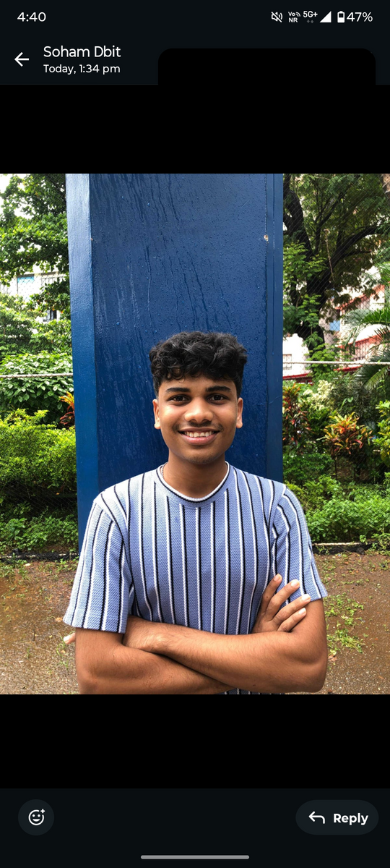
The Bombay Salesian Society’s DON BOSCO INSTITUTE OF TECHNOLOGY (An Autonomous Institute Affiliated to University of Mumbai)
Department of Mechanical Engineering
Batch(2024-25)
DTE : EN 3208
Congratulations
Placed In
Christopher Vaz
5 LPA
Aaryan pawar
5 LPA
Help Each Other - Don Bosco
placementcell_dbit
www.dbit.in
Don Bosco Institute of Technology (D.B.I.T )

Slide 14
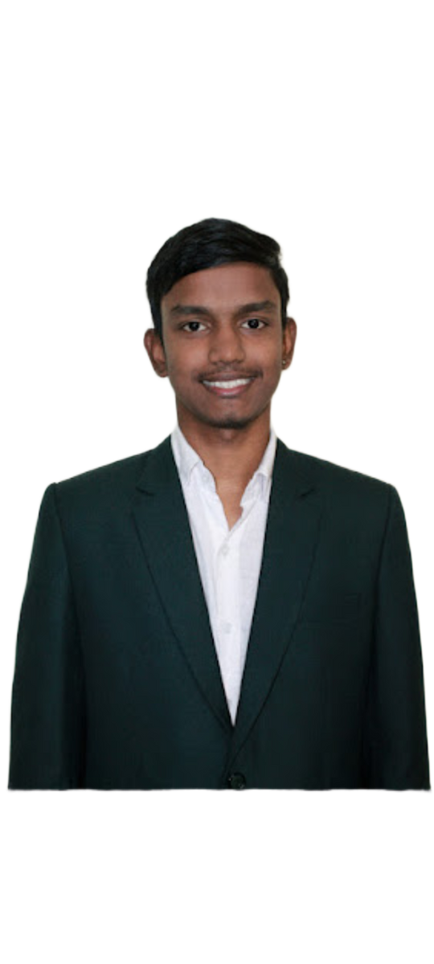
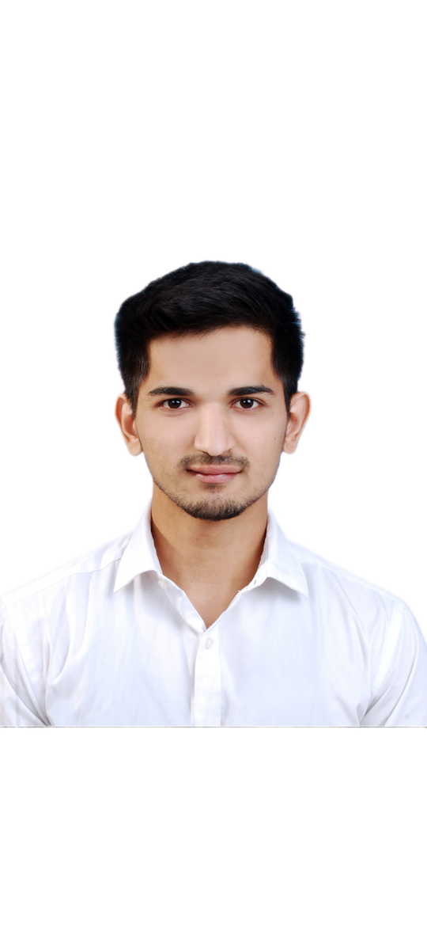

The Bombay Salesian Society’s DON BOSCO INSTITUTE OF TECHNOLOGY (An Autonomous Institute Affiliated to University of Mumbai)
Department of Mechanical Engineering
Batch(2024-25)
DTE : EN 3208
Congratulations
Placed In
Sanjay Gundeti
5 LPA
Sagar Gawle
5 LPA
Help Each Other - Don Bosco
placementcell_dbit
www.dbit.in
Don Bosco Institute of Technology (D.B.I.T )

Slide 15
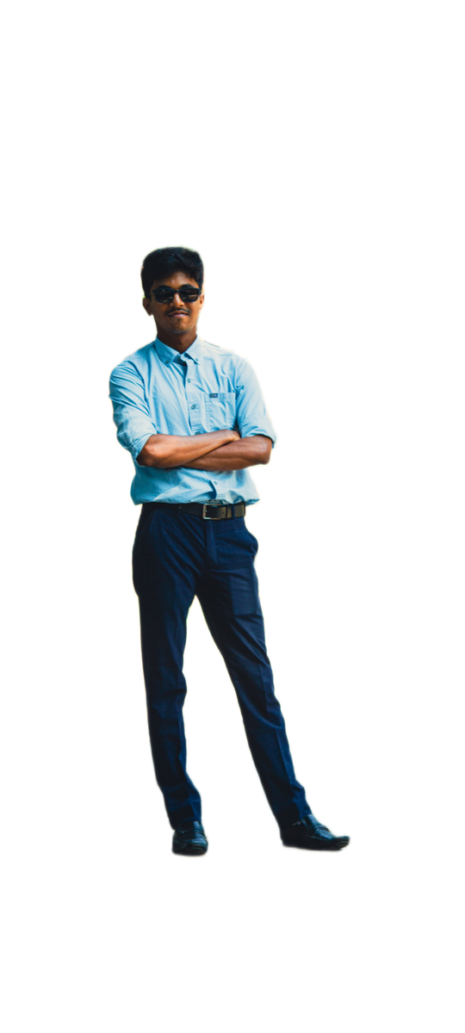

The Bombay Salesian Society’s DON BOSCO INSTITUTE OF TECHNOLOGY (An Autonomous Institute Affiliated to University of Mumbai)
Department of Mechanical Engineering
Batch(2024-25)
DTE : EN 3208
Congratulations
Placed In
Ankur Khutwad
5 LPA
Help Each Other - Don Bosco
placementcell_dbit
www.dbit.in
Don Bosco Institute of Technology (D.B.I.T )

Slide 16
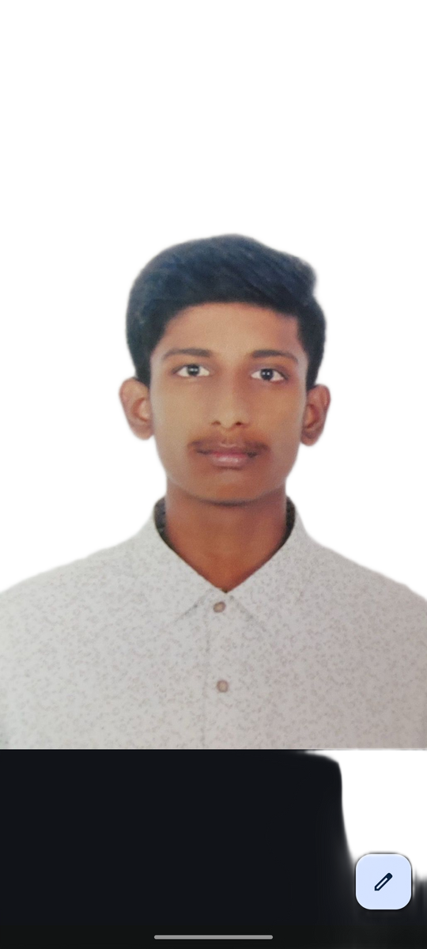

The Bombay Salesian Society’s DON BOSCO INSTITUTE OF TECHNOLOGY (An Autonomous Institute Affiliated to University of Mumbai)
Department of Mechanical Engineering
Batch(2024-25)
DTE : EN 3208
Congratulations
Placed In
Tyrell Pires
5 LPA
Help Each Other - Don Bosco
placementcell_dbit
www.dbit.in
Don Bosco Institute of Technology (D.B.I.T )

Slide 17
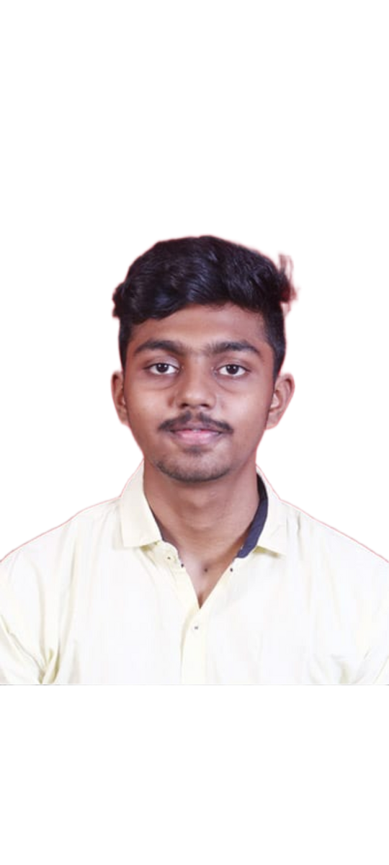

The Bombay Salesian Society’s DON BOSCO INSTITUTE OF TECHNOLOGY (An Autonomous Institute Affiliated to University of Mumbai)
Department of Mechanical Engineering
Batch(2024-25)
DTE : EN 3208
Congratulations
Placed In
Akshay Palshetkar
5 LPA
Help Each Other - Don Bosco
placementcell_dbit
www.dbit.in
Don Bosco Institute of Technology (D.B.I.T )

Slide 18
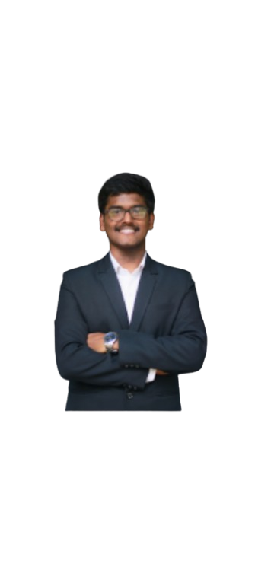

The Bombay Salesian Society’s DON BOSCO INSTITUTE OF TECHNOLOGY (An Autonomous Institute Affiliated to University of Mumbai)
Department of Mechanical Engineering
Batch(2024-25)
DTE : EN 3208
Congratulations
Placed In
Shardul Mahadik
4.8 LPA
Help Each Other - Don Bosco
placementcell_dbit
www.dbit.in
Don Bosco Institute of Technology (D.B.I.T )

Slide 19
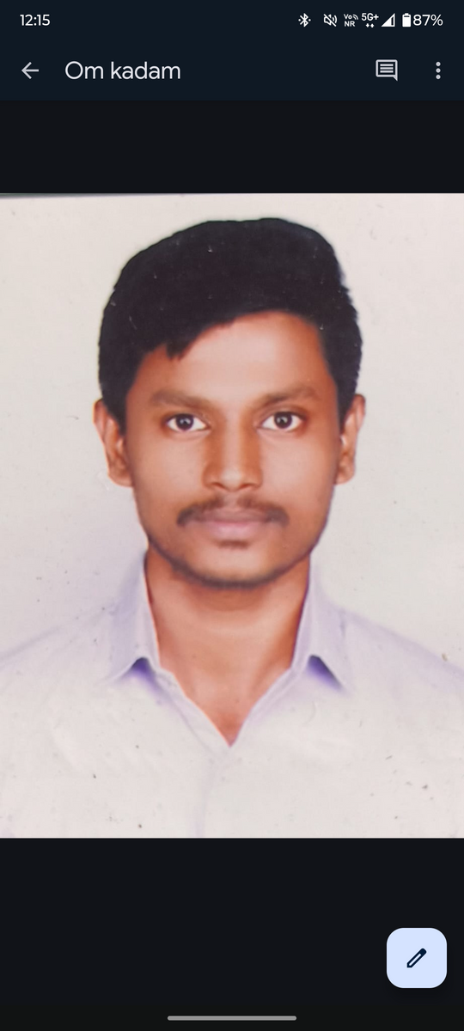
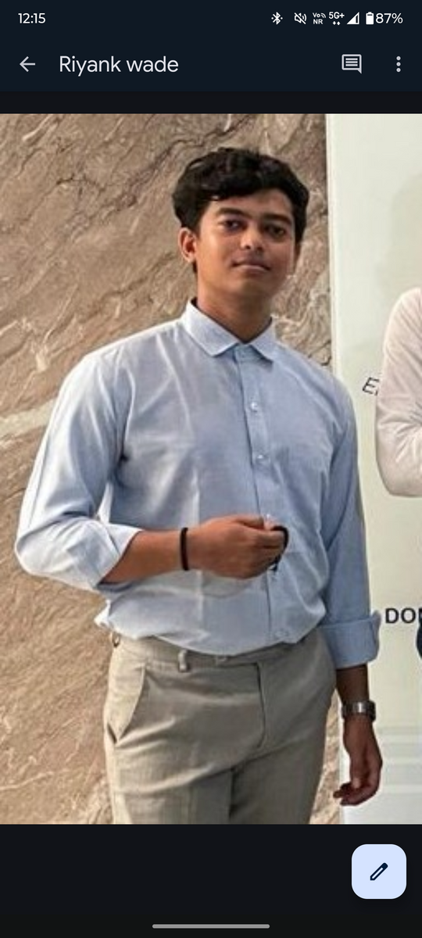

The Bombay Salesian Society’s DON BOSCO INSTITUTE OF TECHNOLOGY (An Autonomous Institute Affiliated to University of Mumbai)
Department of Mechanical Engineering
Batch(2024-25)
DTE : EN 3208
Congratulations
Placed In
Om kadam
4.5 LPA
Riyank Wade
4.5 LPA
Help Each Other - Don Bosco
placementcell_dbit
www.dbit.in
Don Bosco Institute of Technology (D.B.I.T )

Slide 20
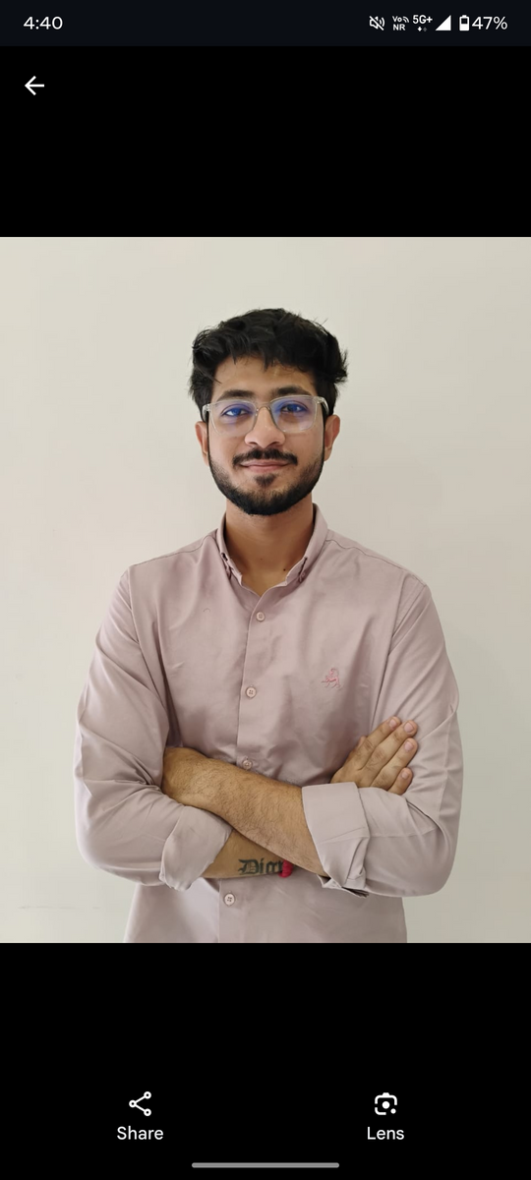
The Bombay Salesian Society’s DON BOSCO INSTITUTE OF TECHNOLOGY (An Autonomous Institute Affiliated to University of Mumbai)
Department of Mechanical Engineering
Batch(2024-25)
DTE : EN 3208
Congratulations
Placed In
Rugved Sonwane
4.5 LPA
Help Each Other - Don Bosco
placementcell_dbit
www.dbit.in
Don Bosco Institute of Technology (D.B.I.T )

Slide 21


The Bombay Salesian Society’s DON BOSCO INSTITUTE OF TECHNOLOGY (An Autonomous Institute Affiliated to University of Mumbai)
Department of Mechanical Engineering
Batch(2024-25)
DTE : EN 3208
Congratulations
Placed In
Sarvesh Bangera
4 LPA
Help Each Other - Don Bosco
placementcell_dbit
www.dbit.in
Don Bosco Institute of Technology (D.B.I.T )

Slide 22

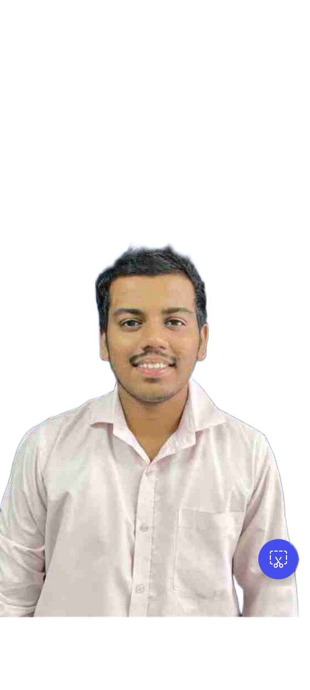
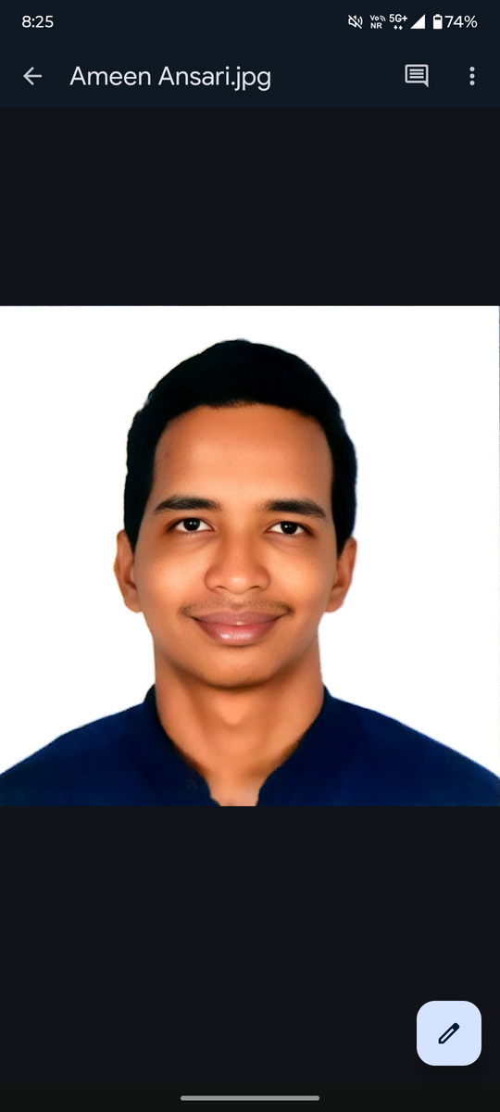
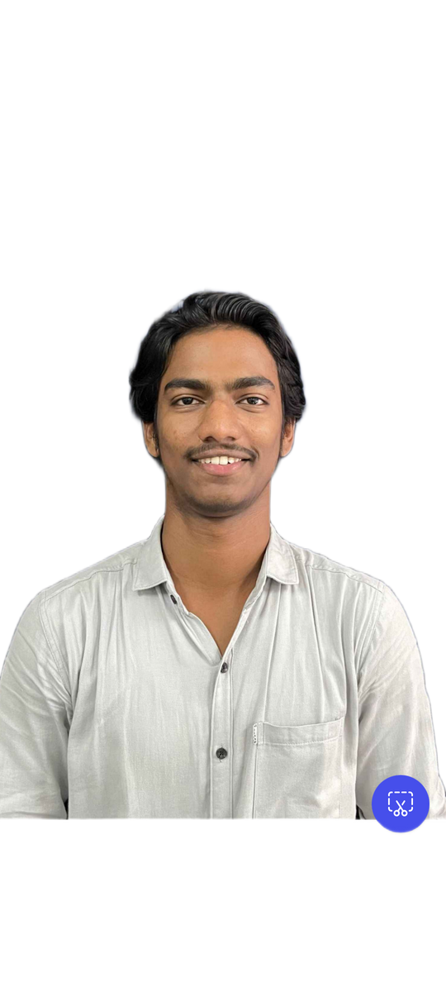
The Bombay Salesian Society’s DON BOSCO INSTITUTE OF TECHNOLOGY (An Autonomous Institute Affiliated to University of Mumbai)
Department of Mechanical Engineering
Batch(2024-25)
DTE : EN 3208
Congratulations
Placed In
Truptesh Patil
3.5 LPA
Aniket Kadam
3.5LPA
Ameen Ansari
3.5LPA
Help Each Other - Don Bosco
placementcell_dbit
www.dbit.in
Don Bosco Institute of Technology (D.B.I.T )

Slide 23

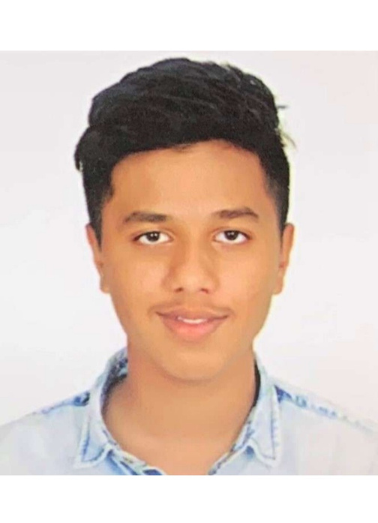
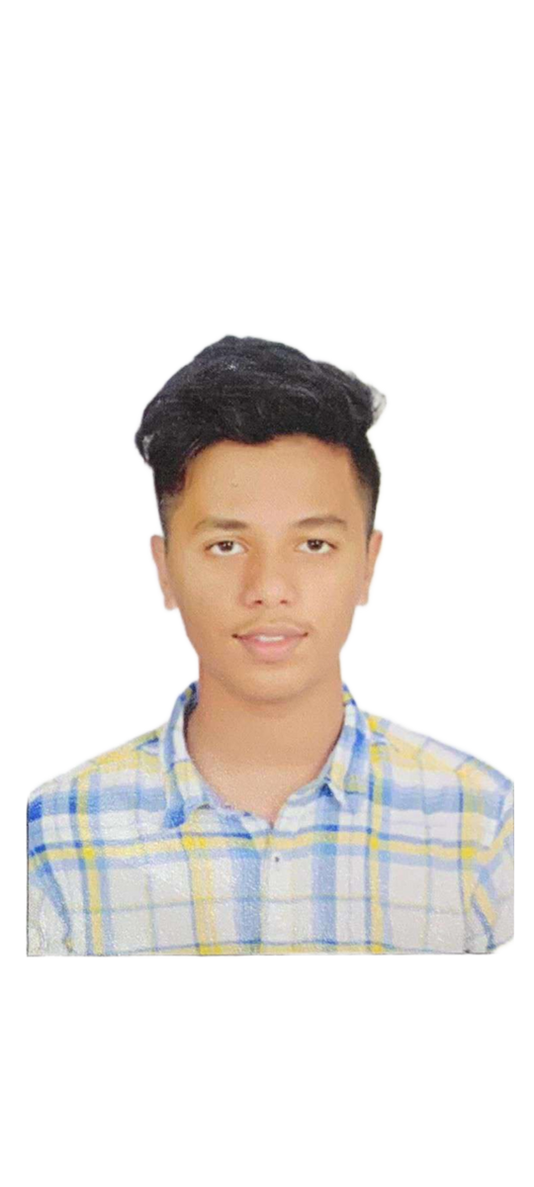
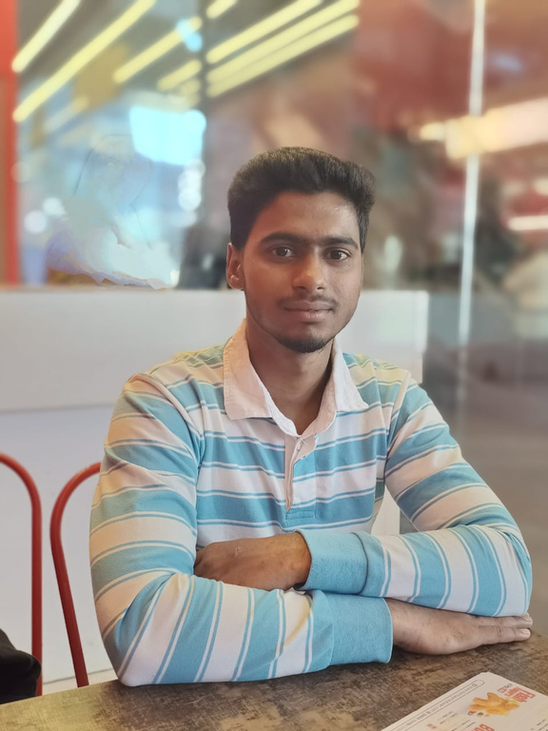
The Bombay Salesian Society’s DON BOSCO INSTITUTE OF TECHNOLOGY (An Autonomous Institute Affiliated to University of Mumbai)
Department of Mechanical Engineering
Batch(2024-25)
DTE : EN 3208
Congratulations
Placed In
Shebhaz Mukadam
3LPA
Amish Palande
3 LPA
Anish Palande
3 LPA
Help Each Other - Don Bosco
placementcell_dbit
www.dbit.in
Don Bosco Institute of Technology (D.B.I.T )

Slide 24


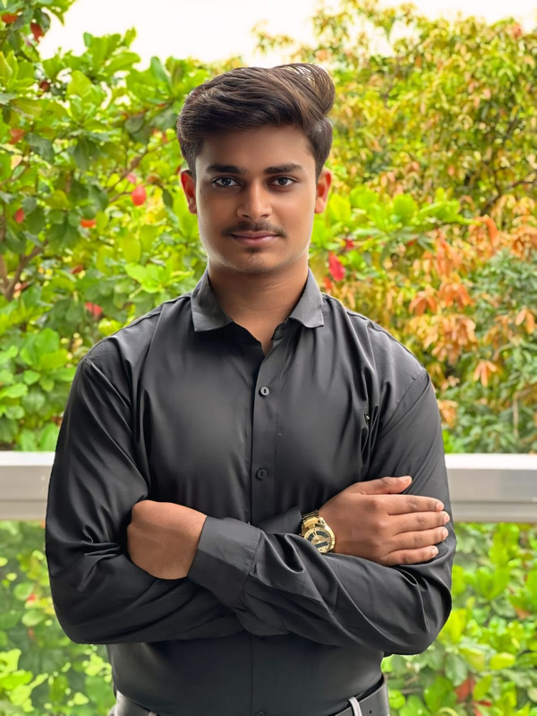
The Bombay Salesian Society’s DON BOSCO INSTITUTE OF TECHNOLOGY (An Autonomous Institute Affiliated to University of Mumbai)
Department of Mechanical Engineering
Batch(2024-25)
DTE : EN 3208
Congratulations
Placed In
Aniruddh Jadhav
3 LPA
Abdul Salam
3 LPA
Help Each Other - Don Bosco
placementcell_dbit
www.dbit.in
Don Bosco Institute of Technology (D.B.I.T )

Slide 25
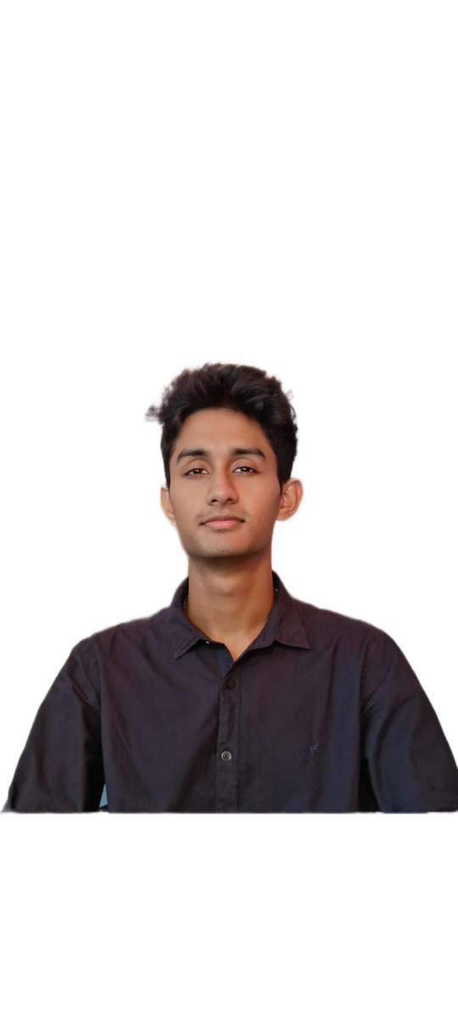

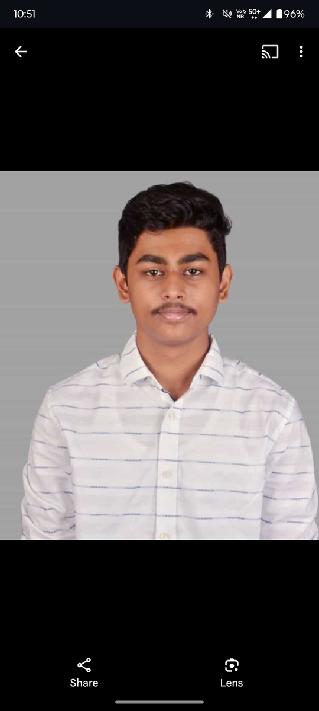
The Bombay Salesian Society’s DON BOSCO INSTITUTE OF TECHNOLOGY (An Autonomous Institute Affiliated to University of Mumbai)
Department of Mechanical Engineering
Batch(2024-25)
DTE : EN 3208
Congratulations
Placed In
Soham Ghag
3 LPA
Aryan Ghad
3 LPA
Help Each Other - Don Bosco
placementcell_dbit
www.dbit.in
Don Bosco Institute of Technology (D.B.I.T )

Slide 26
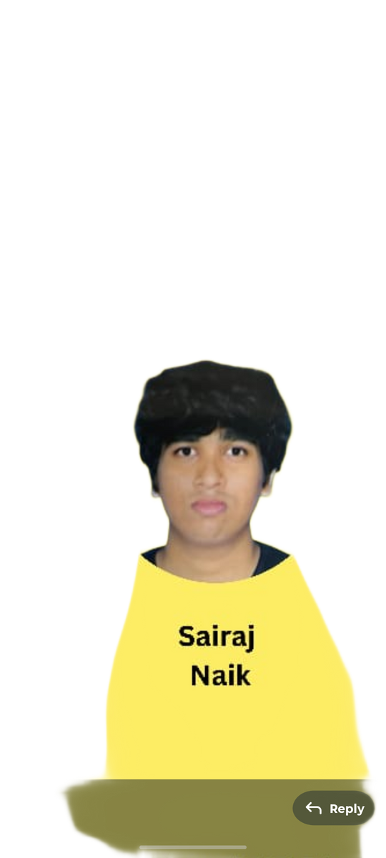


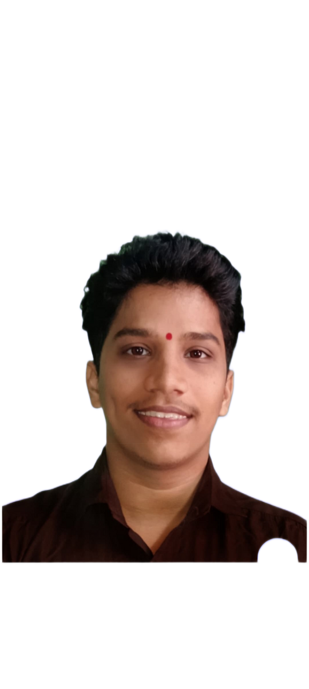
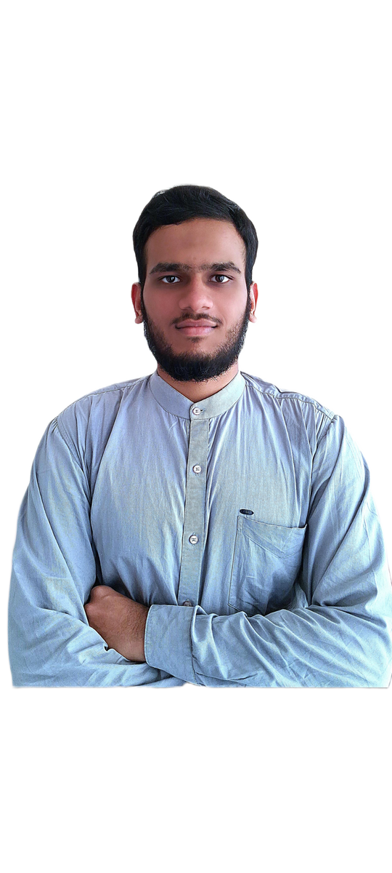

The Bombay Salesian Society’s DON BOSCO INSTITUTE OF TECHNOLOGY (An Autonomous Institute Affiliated to University of Mumbai)
Department of Mechanical Engineering
Batch(2024-25)
DTE : EN 3208
Congratulations
Placed In
Ruturaj Kate
3 LPA
Kunal Nikam
3 LPA
Dhruv Kene
3 LPA
Suraj Naik
3 LPA
Md Ali Karbhari
3 LPA
Help Each Other - Don Bosco
placementcell_dbit
www.dbit.in
Don Bosco Institute of Technology (D.B.I.T )

Slide 27
THANK YOU

